Slide 1
Shopping App
An app for online shopping

Slide 2
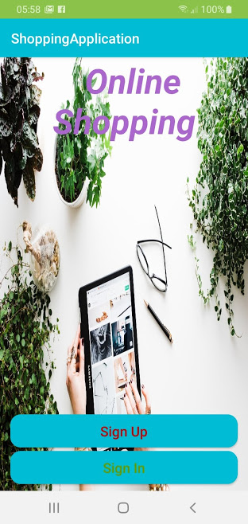
The Team
Abdullah Abbas Barahow
Aklilu Ghebremedhin
Karl Ingemar Javier Lundh
Lavdim Imeri
Robert Alm

Slide 3
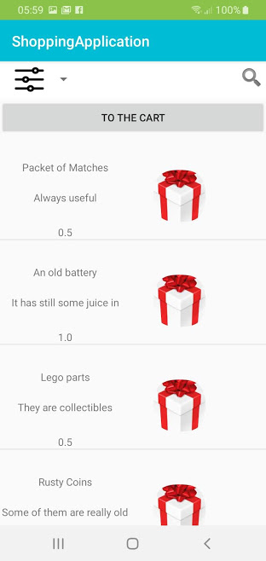
Shopping app
As online shopping becomes more and more prominent, android developers around the world compete to create apps that can cover the needs of the buyer.
Our focus was to create a simple and light app that will allow the user to make his purchases as quickly, easy and safely as possible

Slide 4
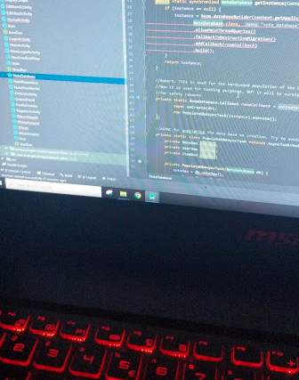
What could have been better?

Slide 5
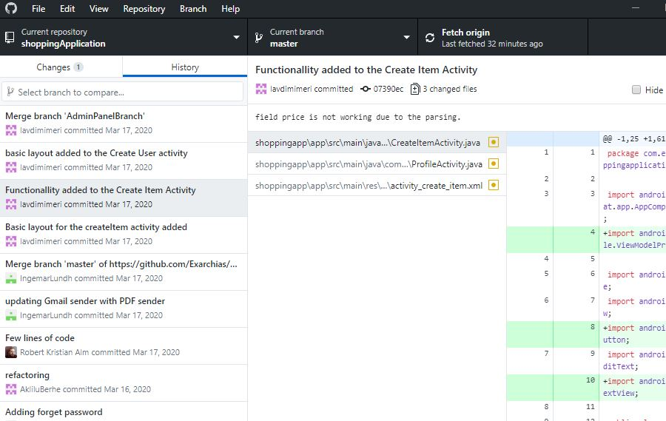
Git and GitHub
Avoiding conflicts it is always a struggle
GitHub Desktop it is a good tool to use
The use of branches was helpful to avoid conflicts
Conflicts need patience to be solved correctly
Git and GitHub are both a great fun!

Slide 6







Future plans
The Admin would be able to see everything from the user’s perspective
The Admin will be able to have an overview of the orders
The app will be able to track the inventory and to inform users and admins about it
Better Design
More intuitive UX, (User Experience)
Live Data
Better Security

Slide 7

Meetings

Slide 8
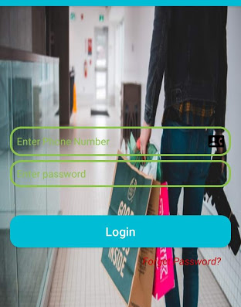
Login and Register
The user can login, register, or reset their password
Reset password verifies the user through SMS
The passwords are stored encrypted in hash encryption
For the login the telephone of the user is used and a password

Slide 9
Dashboard
Dashboard is the home page for the whole app
A side bar offers access to the shopping card, to the purchase history, to settings and to logout button.
All the items that the user can buy are displayed on the Dashboard. The user can select the easily and add them to the shopping cart
When the user is admin, then she has access to the Admin panel

Slide 10
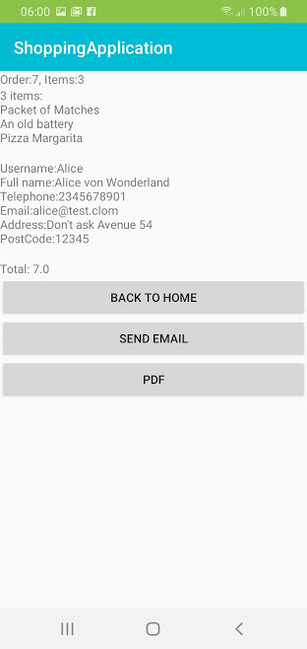
Shopping Cart and the Invoice
The user can add any available item in his shopping cart where he can confirm the order
If the user confirms a checkout, then the transaction is completed, and he gets to the display of the invoice of the order
When in the invoice page, the user has the option to have an email with the invoice or a pdf

Slide 11
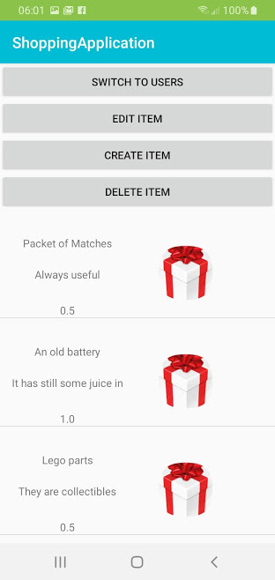
The Admin Panel
The admin can easily overview the available items and the registered users
The design is very intuitive and allows the admin to work easily
The admin can create, edit and delete both items and users

Slide 12
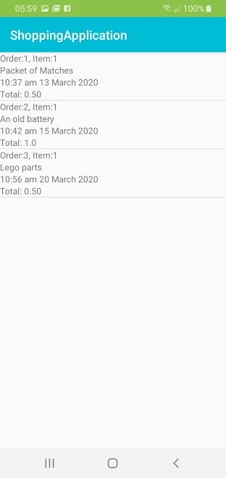
Purchase History
The user can see the history of his activity and his orders at any time through the “Display Orders” panel which displays the orders
Each order has a title and a detailed description and displays the sum and the time of each order

Slide 13
Architecture
The main idea is that any input and output is taken cared in the same way
We achieve that by having a translator in the middle which is translating the Data to OOP and the OOP to Data.
A central IO management reduces bugs and redundancy
The project supports both MVVM and MVC architectures
We didn’t used Live Data to our displays, but it is supported, (probably for future use)

Slide 14
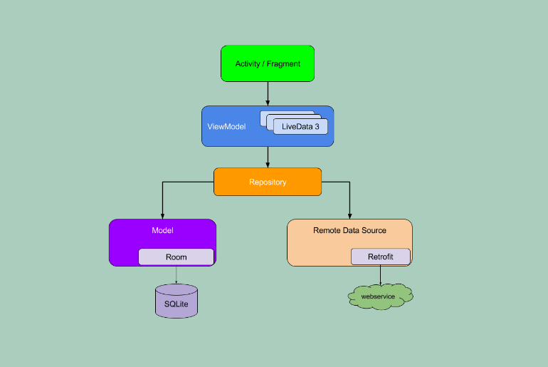
Model View ViewModel
Part of the android architecture components
The future of android development
Great for the 90% of the Android applications out there
It locks the developers inside the box, as it doesn’t allow any creativity outside its narrow limits.
It has few great tricks like Rooms and LiveData

Slide 15
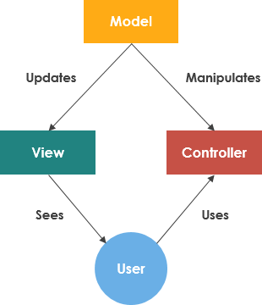
Model View Controller
It works well for us
It becomes a legacy for Android systems
More freedom
Not good for Architecture Components
More popular outside the Android community
Reminds JavaFX

Slide 16

Data Bases
A good reason for stress
Having to access the Databases directly reduces flexibility and scalability
We implemented a system that takes care any possible, (preferably relational), Data Base that might get connected to the app
Right Now we are working with SQLite, (through Rooms), and MySQL There is a good possibility to use NoSQL Databases in the future.

Slide 17
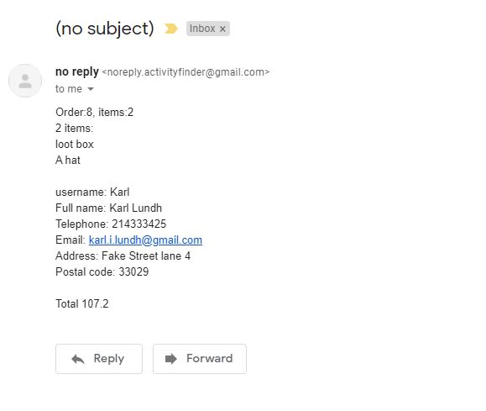
Other Inputs/Outputs
The app can send email through GmailSender
The app can SMS messages
The app can extract the invoice as PDF
The app in the future will probably use Google maps and google calendars

Slide 18
We thank you for your time!
Abdullah Abbas Barahow
Aklilu Ghebremedhin
Karl Ingemar Javier Lundh
Lavdim Imeri
Robert Alm

